Slide 1
Liquid Propulsion
Week 6 PRESENTATION

Slide 2
Presentation Outline
1. Summary of Progress made
2. Objectives for coming week

Slide 3
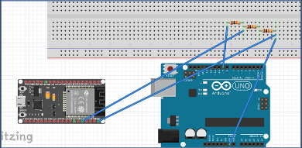
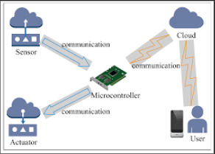
1. Summary of Progress made
Acquisition of components: Microcontroller and sensors
Code implementation:
Serial communication between master (Esp32) and slave (Mega 2560) for passing sensor data.
Communication between Esp32 and database using MQTT requests.
Flow meters calibration code (as high as 99.4% accuracy).

Slide 4
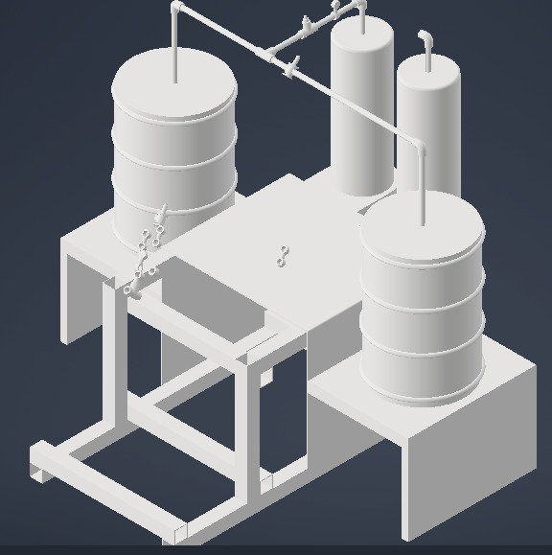
Progress made
CAD modellings
New spacer redesign for directing
coolant flow.
Test stand modification for awaiting
pressure vessel.
Hydraulic system modelling
(control mechanism of pressure valves)

Slide 5
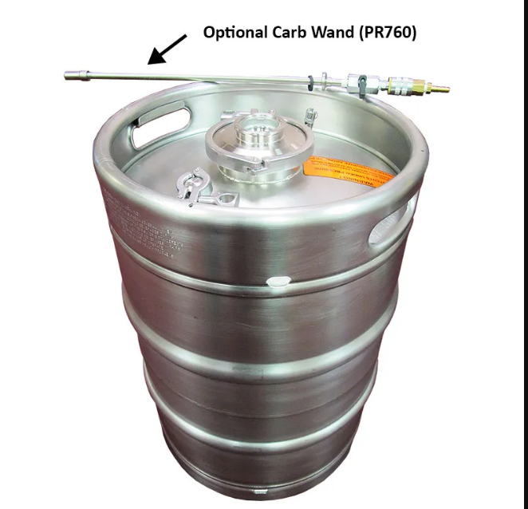
Progress made
Selection of pressure vessel
( beer keg -15 bars for high
pressure test)

Slide 6
2. Objectives for next week
Remaining codes to be implemented
(Pressure sensors, pump control, controlled valve-actuation)
Hydraulic system modelling with an ideal pressure vessel
Building circuitry
Conduct low pressure test

Slide 7
Thank you

